Slide 1
Unit – II
Solar PV modules and PV systems
PV Module Circuit Design
Module Structure
Packing Density
Interconnections
Mismatch
Temperature Effects
Electrical and Mechanical Insulation
Lifetime of PV Modules
Degradation and Failure
PV Module Parameters
Efficiency of PV Module
Solar PV Systems
Battery Operation
Types of Batteries
Battery Parameters
Selection of Batteries for Solar PV System
Applications

Slide 2
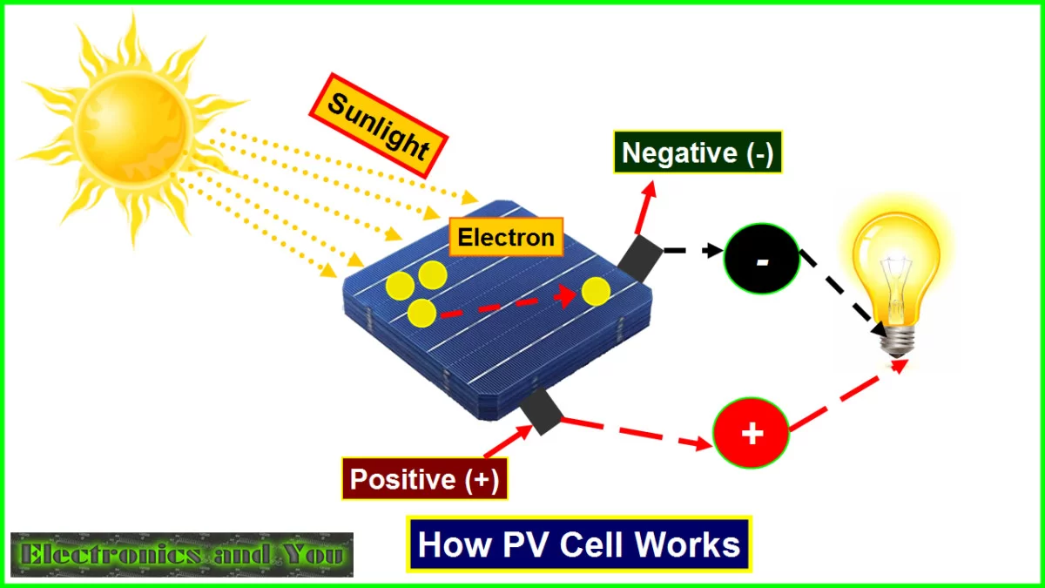
Introduction to solar PV modules and PV systems:
A solar cell is an electrical device that converts the energy of light directly into electricity by the photovoltaic effect, which is a physical and chemical phenomenon.
It is a form of photoelectric cell, defined as a device whose electrical characteristics, such as current, voltage, or resistance, vary when exposed to light.
Solar cell working:
A solar cell is a sandwich of n-type silicon and p-type silicon.
It generates electricity by using sunlight.
When sunlight shines on the cell, photons (light particles) bombard the upper surface.
The photons (yellow blobs) carry their energy down through the cell.
The photons give up their energy to electrons (green blobs) in the lower, p-type layer.
The electrons use this energy to jump across the barrier into the upper, n-type layer and escape out into the circuit.
Flowing around the circuit, the electrons make the lamp light up.

Slide 3
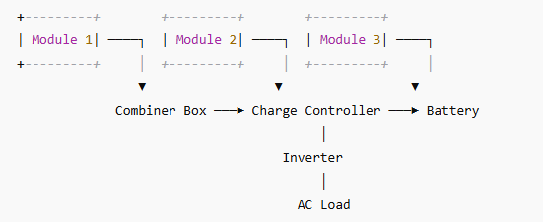
PV module circuit design:
A PV module (solar panel) is made of many solar cells connected together.
Solar cells are the building blocks of photovoltaic modules, known as solar panels.
Each solar cell produces a small voltage (~0.5V).
To get useful power, we connect many cells in a circuit.
[Cell 1] ─── [Cell 2] ─── [Cell 3] ─── [Cell 4]
0.5V 0.5V 0.5V 0.5V → Total = 2V
Fig: Diagram of PV module system

Slide 4
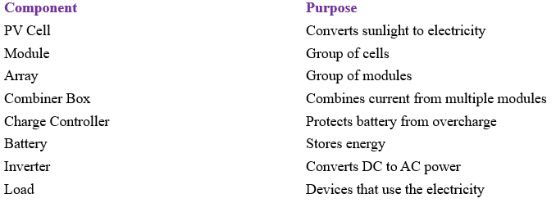
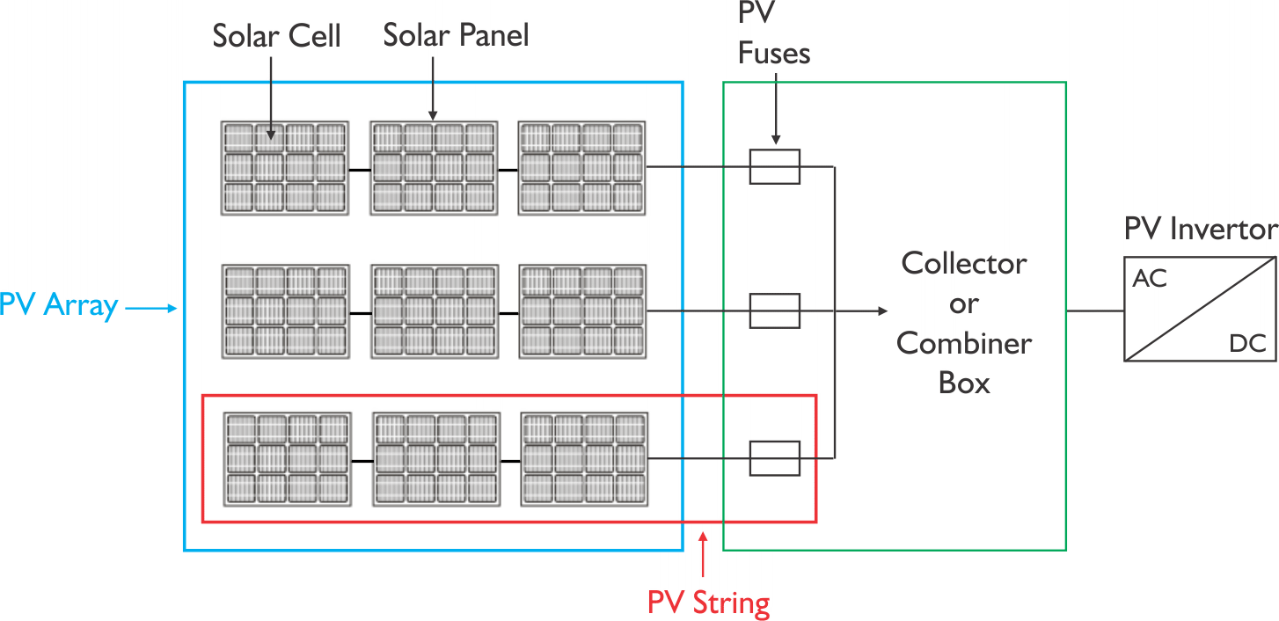
Key components in PV design:
Fig: Circuit diagram of PV module system

Slide 5
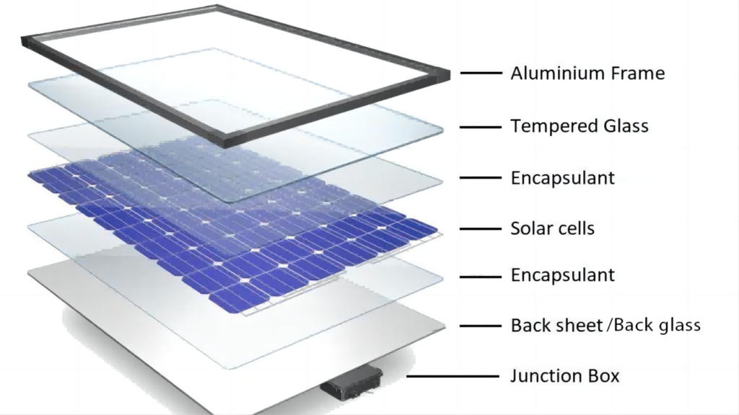
PV module structure:
A PV module is made up of several solar cells arranged and protected in layers to generate electricity from sunlight and last for many years.
Layer | Function
1. Glass Cover | Transparent, protects cells from rain, hail, dust
2. EVA Layer | Soft plastic layer that holds the solar cells and cushions them
3. Solar Cells | Main layer that converts sunlight into DC electricity
4. EVA Layer | Covers cells from below; bonds with the back-sheet
5. Back-sheet | Insulating plastic sheet, protects the back of the module from moisture and mechanical damage
6. Aluminium Frame | Provides mechanical strength and support for mounting
7. Junction Box | Electrical output comes from here; contains bypass diodes to protect the module from shading issues
Fig: Structure of PV module

Slide 6
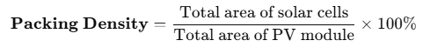
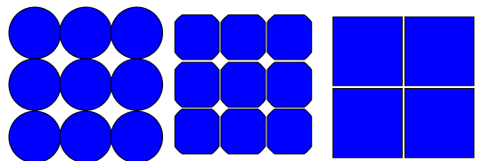
PV module packing density :
Packing density in solar PV modules refers to how much of the module area is actually active solar cell area (the part that generates electricity), compared to the total area of the module.
Fig: Packing density representation
From the above figure packing density is observed as,
The packing density of round and square cells are shown above.
The round type cells give a low packing density.
So, the edges are cut off to produce semi-square cells give higher packing density compared with round cells.
Whereas square cells, giving a high packing density among all.

Slide 7
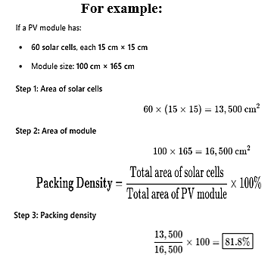
Importance of packing density
Higher packing density: More sunlight is used → Better efficiency per unit area
Lower packing density: More space between cells → Less energy per area
Factors affecting packing density:
Factor | Effect
Cell spacing | More spacing → Lower density
Busbars and gaps | Needed for wiring, but reduce active area
Cell shape | Round cells waste corner space; square cells fit better
Design layout | Smart layout can reduce unused area

Slide 8
PV module interconnections:
Solar cells are tiny units that produce electricity when sunlight hits them. But one solar cell alone produces only about 0.5 volts. So, we connect many cells together to make useful voltage and power.
Types of interconnections
1. Series connection:
Cells are connected positive to negative.
Voltage adds up, current stays the same.
[ + Cell - ]───[ + Cell - ]───[ + Cell - ]
0.5V 0.5V 0.5V → Total Voltage = 1.5V
2. Parallel connection:
Cells are connected positive to positive, negative to negative.
Current adds up, voltage stays the same.
[ + Cell - ]
│
[ + Cell - ]─── Total Current = I₁ + I₂
│
[ + Cell - ]

Slide 9
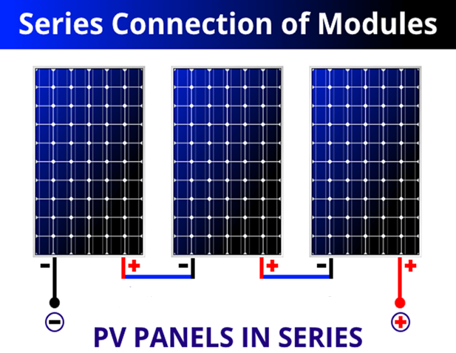
3. Series-Parallel connection (in PV Modules)
Used to get both higher voltage and current.
Combines both series and parallel configurations.
Row 1: Cell1──Cell2──Cell3 (Series)
│
Row 2: Cell4──Cell5──Cell6 (Series)
│
→ Rows connected in parallel
Table: PV cell interconnections
Figure: PV cell interconnections
Connection | Voltage | Current
Series | Adds up | Same
Parallel | Same | Adds up
Combo | Both | Both

Slide 10
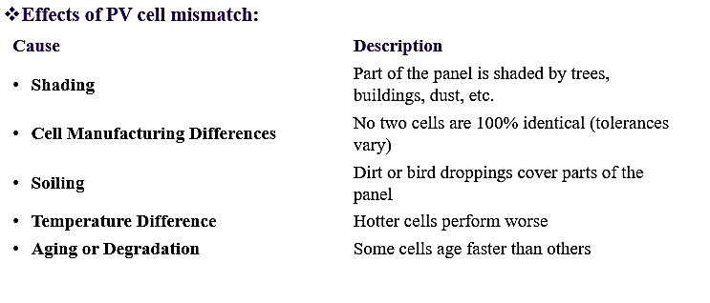
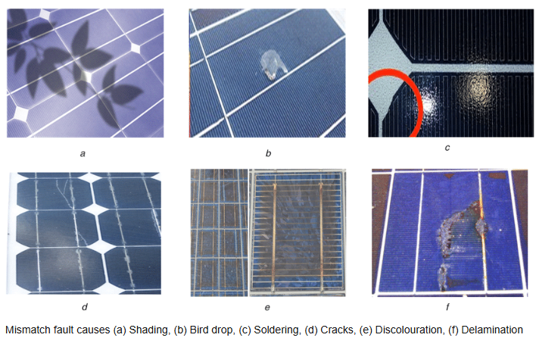
PV cells mismatch:
Solar cell mismatch happens when solar cells connected together don’t perform equally, some cells produce more current or voltage than others.
This can cause power loss, hot spots, and reduced efficiency in the whole solar panel.

Slide 11
Consequences of mismatching:
In series connection, weakest cell limits the current.
In parallel connection, strongest cell pushes more current and can overheat weaker ones.
Causes hotspots, reduced power output, and may damage cells.
Example (Series String with Shaded Cell):
[Good Cell]──[Good Cell]──[Shaded Cell]
0.5V 0.5V 0.3V → total voltage drops↓
Methods to minimize the mismatch:
Method | Benefit
Bypass Diodes | Allow current to flow around weak/shaded cells
Cell Sorting/Matching | Grouping similar cells during manufacturing
Proper Installation | Avoid partial shading and dirt buildup
MPPT Controllers | Optimize power output despite mismatches

Slide 12
Temperature Effects on PV cell:
Although solar cells need sunlight to work, too much heat is actually bad for their performance.
Consequences of high temperature:
Effect | Explanation
Voltage Decreases | The output voltage of a solar cell drops as temperature rises.
Current Increases Slightly | There’s a small increase in current, but not enough to balance the voltage loss.
Power Output Drops | Because power = voltage × current, the overall power decreases.
Increase in temp | Voltage ↓, Power ↓
Overall result | Efficiency drops
Temperature Coefficient:
Solar panels come with a temperature coefficient, which tells how much their performance drops per °C increase in temperature.
Power output can drop by 0.4% to 0.5% for every 1°C rise in temperature i.e., –0.4%/°C to –0.5%/°C
Temp ↑ → Voltage ↓ → Power ↓

Slide 13
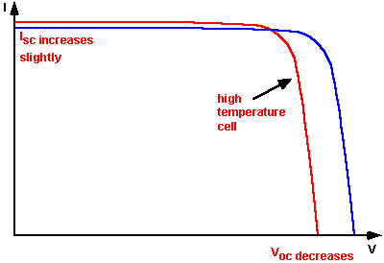
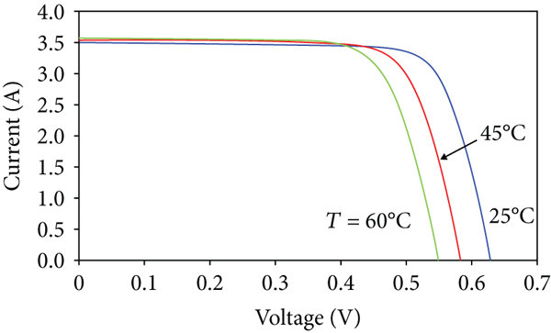
Reasons to get the solar panels hot:
Dark surfaces absorb heat.
Panels can reach 60–80°C even when the air temperature is 30°C.
Methods to reduce temperature effects:
Method | Description
Proper Ventilation | Airflow under panels helps cool them down
Use High-Quality Panels | Panels with better thermal tolerance
Install at Tilt | Allows heat to escape and improves cooling
Solar Tracking | Minimizes unnecessary exposure during hot hours
Best solution | Keep panels cool through good design
Fig: Temperature effects on output

Slide 14
Electrical and mechanical insulation:
Solar cells need both electrical and mechanical insulation to operate safely, efficiently, and durably over 20–30 years in outdoor conditions.
Electrical Insulation:
Electrical insulations are required to prevent short circuits between cells and conductive parts (like frame or mounting).
Ensure safe handling and electrical safety.
Avoid leakage currents and loss of power.
Key components for electrical insulation:
Component | Role
Encapsulant (EVA) | Electrically insulates the solar cell from the top and bottom layers.
Back sheet | An insulating plastic layer (usually PET or Tedlar) that blocks electricity from leaking out the back.
Glass Layer | Though mainly mechanical, it also insulates the front from electrical contact.
Junction Box Design | Uses insulated terminals and bypass diodes to avoid electrical contact with the frame.

Slide 15
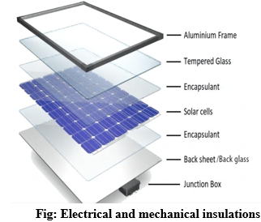
Mechanical insulation (Protection):
Mechanical insulations are required to protect fragile solar cells from cracks, moisture, dust, and mechanical damage.
Ensure durability in harsh environments (wind, hail, snow).
Key components for mechanical insulation:
Component | Function
Tempered glass (Front) | Protects against impact, dust, and water
EVA layers | Cushions the solar cells and absorbs mechanical stress
Back-sheet | Seals the rear side and provides weather resistance
Aluminum frame | Supports the module, protects edges, and allows mounting
Sealants (Edge seal) | Prevent moisture from entering between layers

Slide 16
PV cell degradation and failure:
PV cells degrade over time due to environmental and operational stresses.
This reduces their efficiency and power output.
PV cell degradation:
Degradation refers to the gradual decline in power output due to various internal and external factors.
Typical degradation rate is 0.3% to 1% per year.
Types of degradation:
Type | Description
LID (Light-Induced Degradation) | Occurs during initial exposure to sunlight, especially in silicon cells (due to boron-oxygen complex formation).
PID (Potential-Induced Degradation) | Caused by high system voltage and leakage current, leading to power loss.
Thermal Degradation | Long-term exposure to high temperatures degrades materials and interconnections.
UV Degradation | UV radiation affects encapsulant and surface layers, reducing transparency.
Moisture Ingress | Water vapor entering modules causes corrosion and electrical leakage.
Delamination | Separation of layers (glass, encapsulant, back-sheet), causing performance loss.

Slide 17
PV cell failures:
Failures are sudden or irreversible malfunctions that can drastically reduce or stop power generation.
Common failure modes:
Failure Type | Cause
Cracks in cells | Mechanical stress, improper handling, or thermal expansion
Hot spots | Local overheating due to cell mismatch or shading
Snail trails | Micro cracks + moisture ingress, forming discoloration lines
Glass breakage | Impact or extreme weather
Junction box failure | Poor sealing, overheating, or corrosion
Corrosion | Due to moisture or salt (especially in coastal areas)
Methods to prevent the failure:
Use high-quality materials and manufacturers
Ensure proper installation and handling
Periodic inspection and maintenance
Use bypass diodes to minimize effects of shading and hotspots

Slide 18
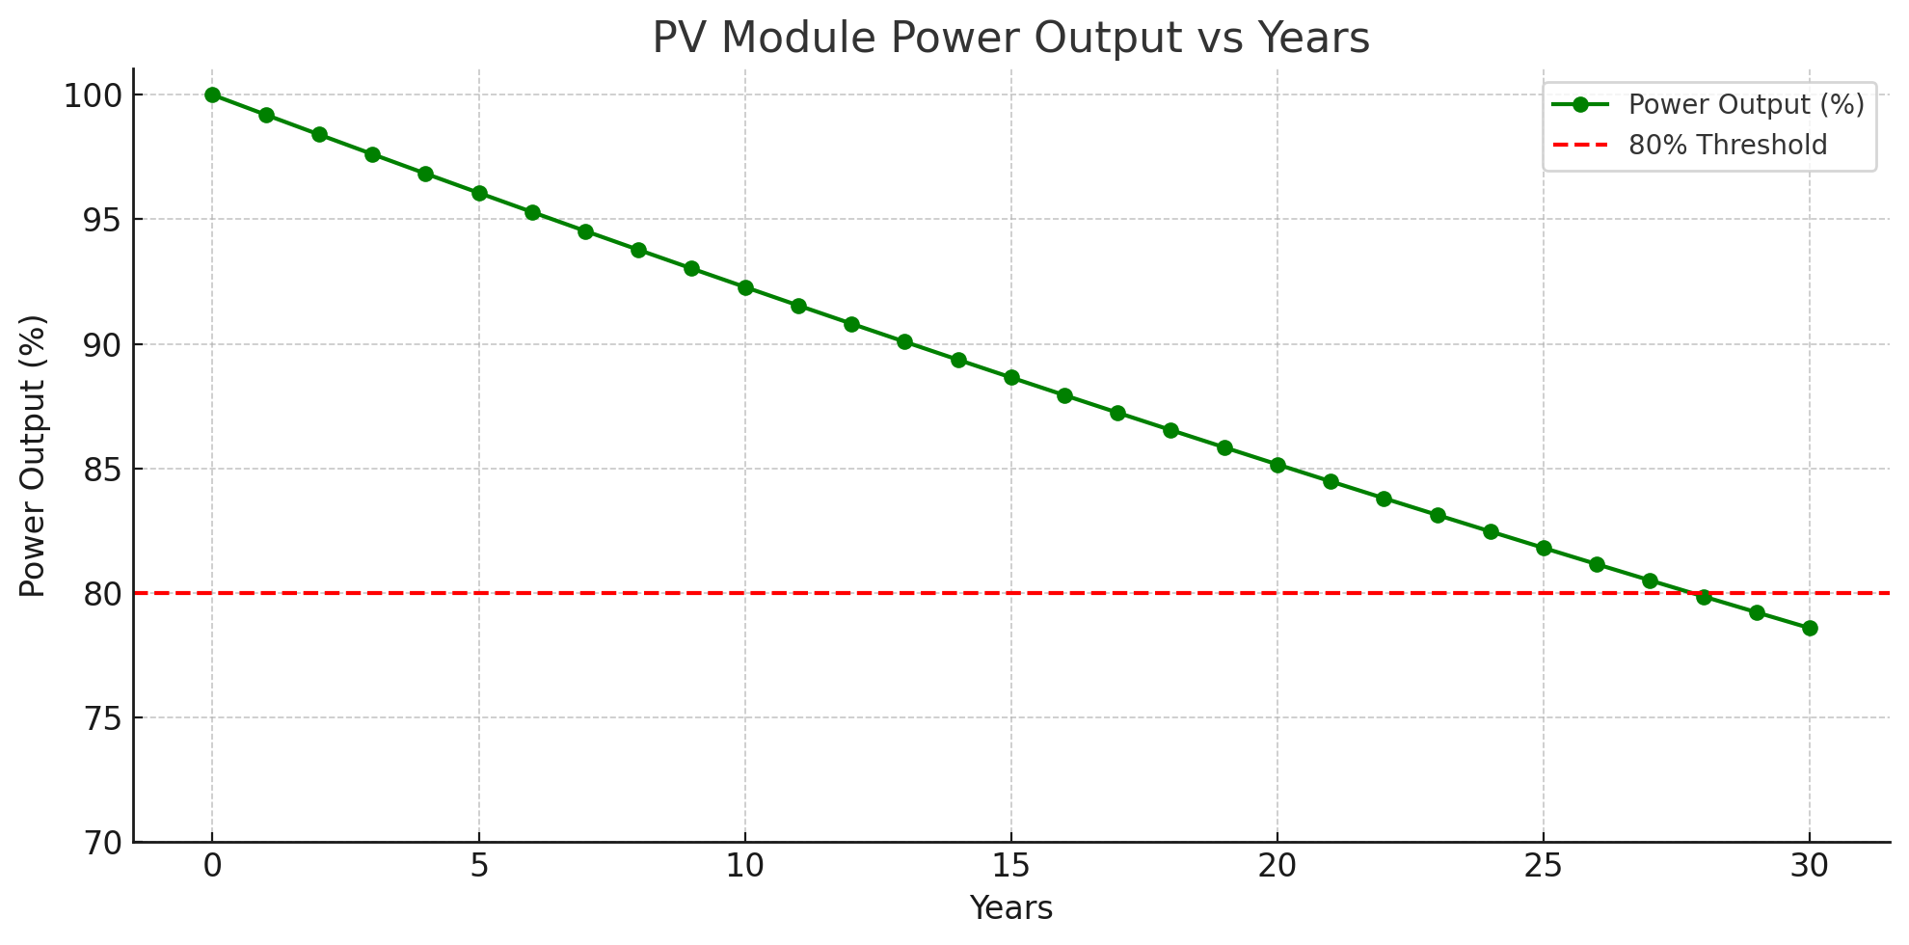
Lifetime of PV modules:
The lifetime of photovoltaic (PV) modules refers to the period over which they can effectively generate electricity.
Typically, PV modules have a lifespan of 25 to 30 years under standard test conditions.
Most manufacturers offer:
Product warranty: 10–12 years (covers manufacturing defects)
Performance warranty: 25 years (ensures 80–90% of initial power output)
Factors affecting lifetime:
Quality of materials
Manufacturing
Installation and mounting systems
Environmental exposure (UV radiation, temperature, humidity)
Maintenance practices
End of life:
Even after 25 years, PV modules can still function but at lower efficiency.
Suitable for reuse in less energy-demanding applications.
Disposal and recycling:
Materials like glass, aluminum, and silicon can be recycled.
Sustainable disposal is encouraged to reduce environmental impact.
Fig: Power output (%) versus Life time (years)

Slide 19
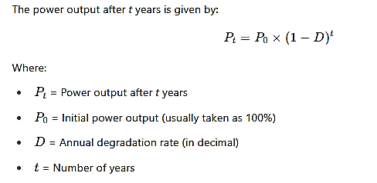
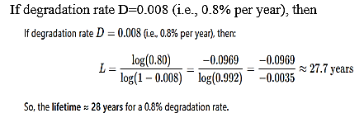
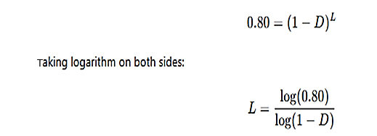
Life time calculation of PV cell by using degradation:
The lifetime of PV modules is generally estimated based on their performance degradation rate over time.
The power output after t years is given by:
To calculate lifetime (L):
We usually consider lifetime as the time taken for the module's power to drop to 80% of its initial value

Slide 20
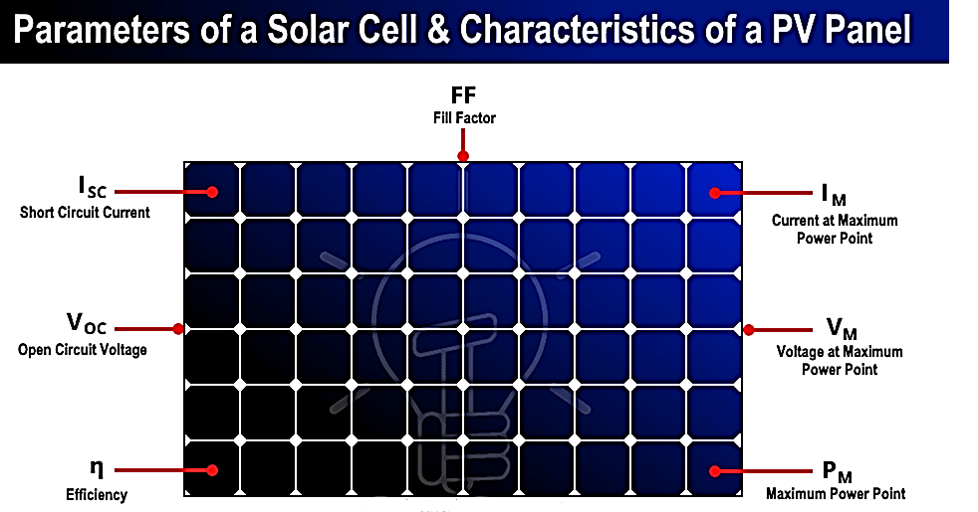
PV module parameters
PV module parameters are crucial for understanding and evaluating the performance of solar panels. Key parameters include short circuit current (Isc), open circuit voltage (Voc), maximum power point (MPP) voltage (Vmpp) and current (Impp), maximum power (Pmax), and fill factor (FF). These parameters, often provided by manufacturers, help determine a module's efficiency and suitability for various applications.
Key PV module parameters:
Short circuit current (Isc): The maximum current a module can produce when its terminals are shorted (no load).
Open circuit voltage (Voc): The maximum voltage a module can produce when no current is flowing (open circuit).
Vmpp (Voltage at MPP): The voltage at the maximum power point.
Impp (Current at MPP): The current at the maximum power point.
Maximum power (Pmax): The highest power output a module can achieve under specific conditions.
Fill factor (FF): A measure of the quality of the I-V curve, indicating how closely it approaches a rectangular shape. Calculated as,
FF=(Pmax) / (Voc × Isc).
Efficiency (η): The ratio of electrical power output to solar power input.
Fig: PV module parameters

Slide 21
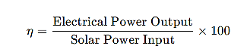
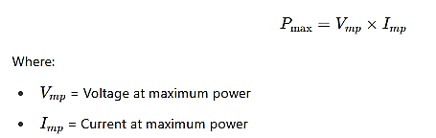
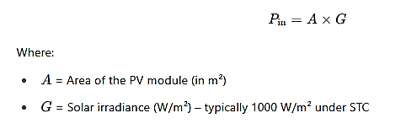
Efficiency of PV module:
The efficiency of a PV (Photovoltaic) module is the percentage of solar energy incident on the module that is converted into usable electrical energy.
Or
Efficiency is the ratio of useful electrical power output to the incident solar power input on the surface of the PV module.
Output Power (Pmax):
The maximum electrical power output of a PV module is given by:
Input Solar Power (Pin)
Input solar power is the amount of sunlight falling on the surface of the PV module.

Slide 22
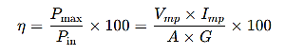
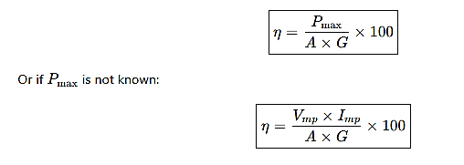
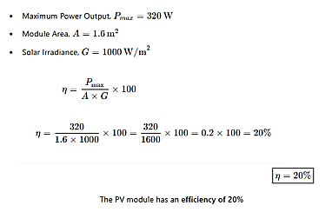
Equation for efficiency of PV module:
For example:

Slide 23
Solar PV systems:
A Solar PV System converts sunlight into electricity using solar panels.
“PV” stands for Photovoltaic, which means light (photo) to electricity (voltaic).
Main components of a PV system:
Solar Panel (PV Module):
Converts sunlight into DC electricity.
Charge Controller:
Regulates voltage and current from the panel to protect the battery.
Battery (optional, for off-grid systems):
Stores energy for use when there is no sunlight.
Inverter:
Converts DC electricity into AC electricity used in homes.
Load:
The electrical devices powered by the system (lights, fans, etc.)

Slide 24
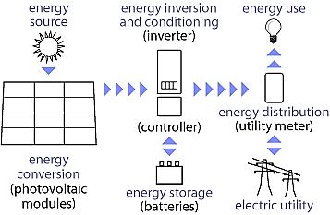
Working of a PV system:
Sunlight falls on the solar panel.
Panel produces DC electricity.
Charge controller regulates the current.
Electricity goes to battery (if used) or directly to inverter.
Inverter changes DC to AC.
AC power is used to run electrical appliances.
[Sunlight] → [Solar Panel] → [Charge Controller] → [Battery] → [Inverter] → [AC Load]
Types of PV systems:
Fig: Working of PV systems
Type | Description | Example
Off-Grid | Not connected to the main grid; uses batteries | Remote villages
On-Grid | Connected to the electricity grid; no battery | Rooftop solar in cities
Hybrid | Both grid + battery backup | Homes with solar + power backup

Slide 25
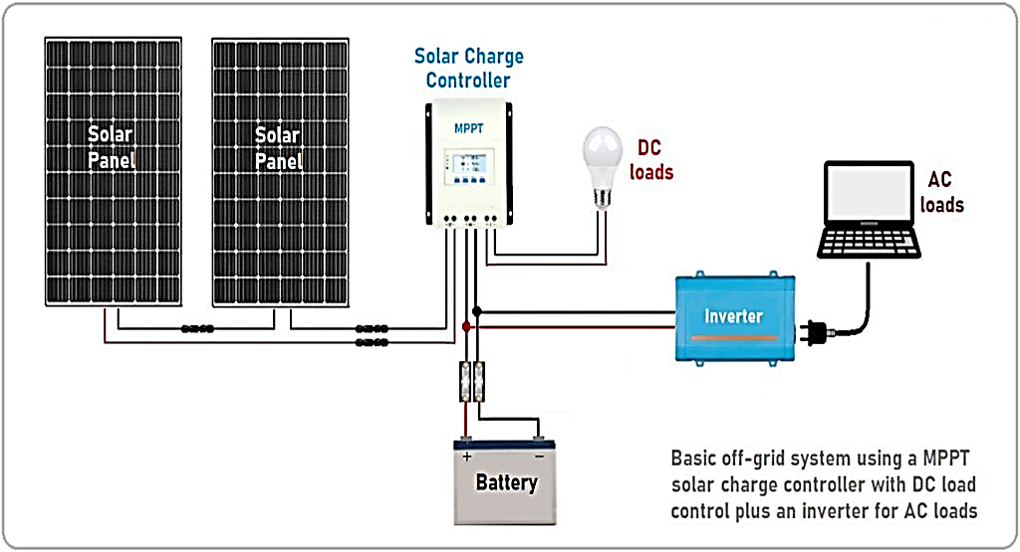
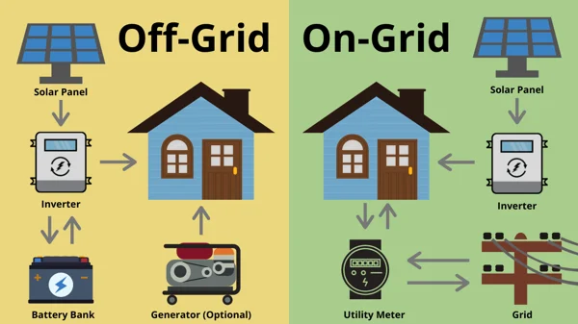
Design of off grid solar power plant:
An off-grid system operates independently of the grid, relying on solar panels and energy storage (usually batteries) to provide electricity.
It uses solar energy to power loads and stores excess energy in batteries for use during nighttime or cloudy days.
Fig: Off grid solar power plant

Slide 26
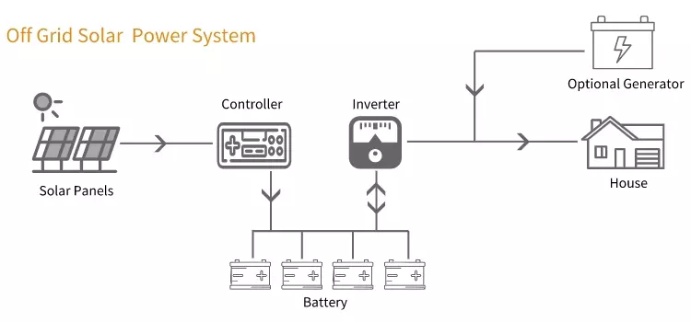
Components of off-grid solar power plant:
Solar PV panels: Convert sunlight into DC electricity.
Charge controller: Regulates voltage and current from PV to batteries.
Battery bank: Stores excess energy for backup use.
Inverter: Converts DC to AC for AC appliances.
Loads: Electrical devices (lights, fans, etc.) powered by the system
Advantages of off-grid system:
Works in remote areas
Energy independence
No grid failures
Limitations:
High initial cost
Battery maintenance required
Limited by battery capacity
Applications:
Rural homes
Forest outposts
Telecom towers
Remote schools and clinics
Fig: Lay out of off grid solar power plant

Slide 27
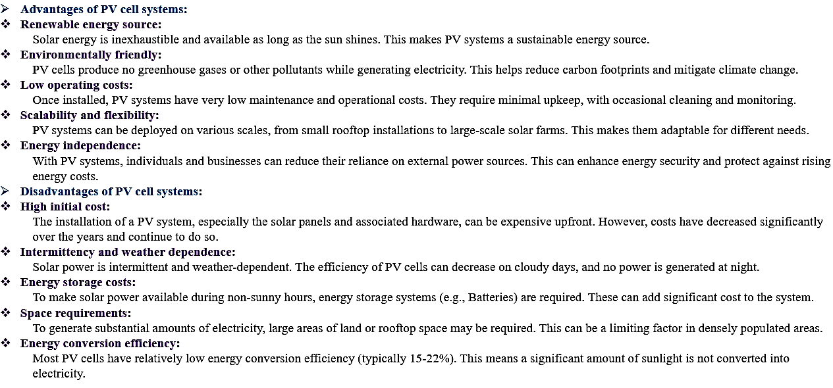
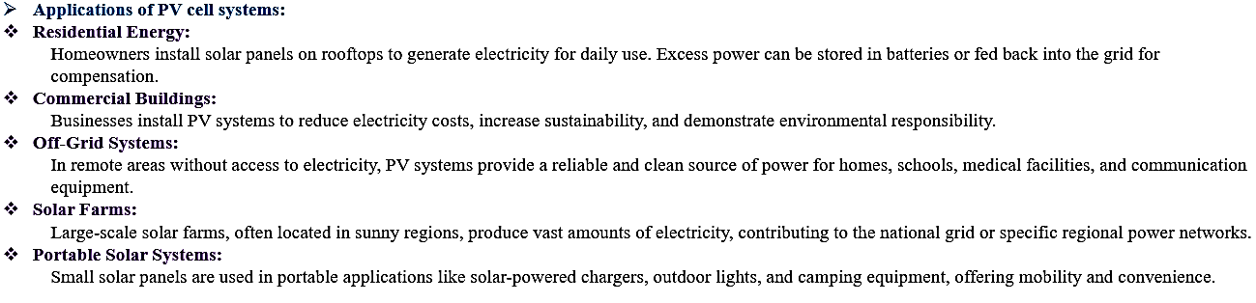

Slide 28
Battery operation:
A battery is a device that converts chemical energy into electrical energy. It typically consists of one or more electrochemical cells connected together, providing a source of direct current.
Purpose of battery in PV System:
To store extra solar energy produced during the day.
To supply power when solar energy is not available (night/cloudy weather).
To provide backup power and maintain a stable supply.
Basic working:
Charging:
When sunlight is available, solar panels generate DC electricity.
Excess power charges the battery via a charge controller.
Storage:
The battery stores the chemical energy for later use.
Discharging:
When there is no sunlight, the battery discharges power to supply the load (like lights, fans).
Battery charging and discharging:
Controlled by a charge controller to avoid overcharging or deep discharging.
Charge controller types:
PWM (Pulse Width Modulation)
MPPT (Maximum Power Point Tracking)

Slide 29
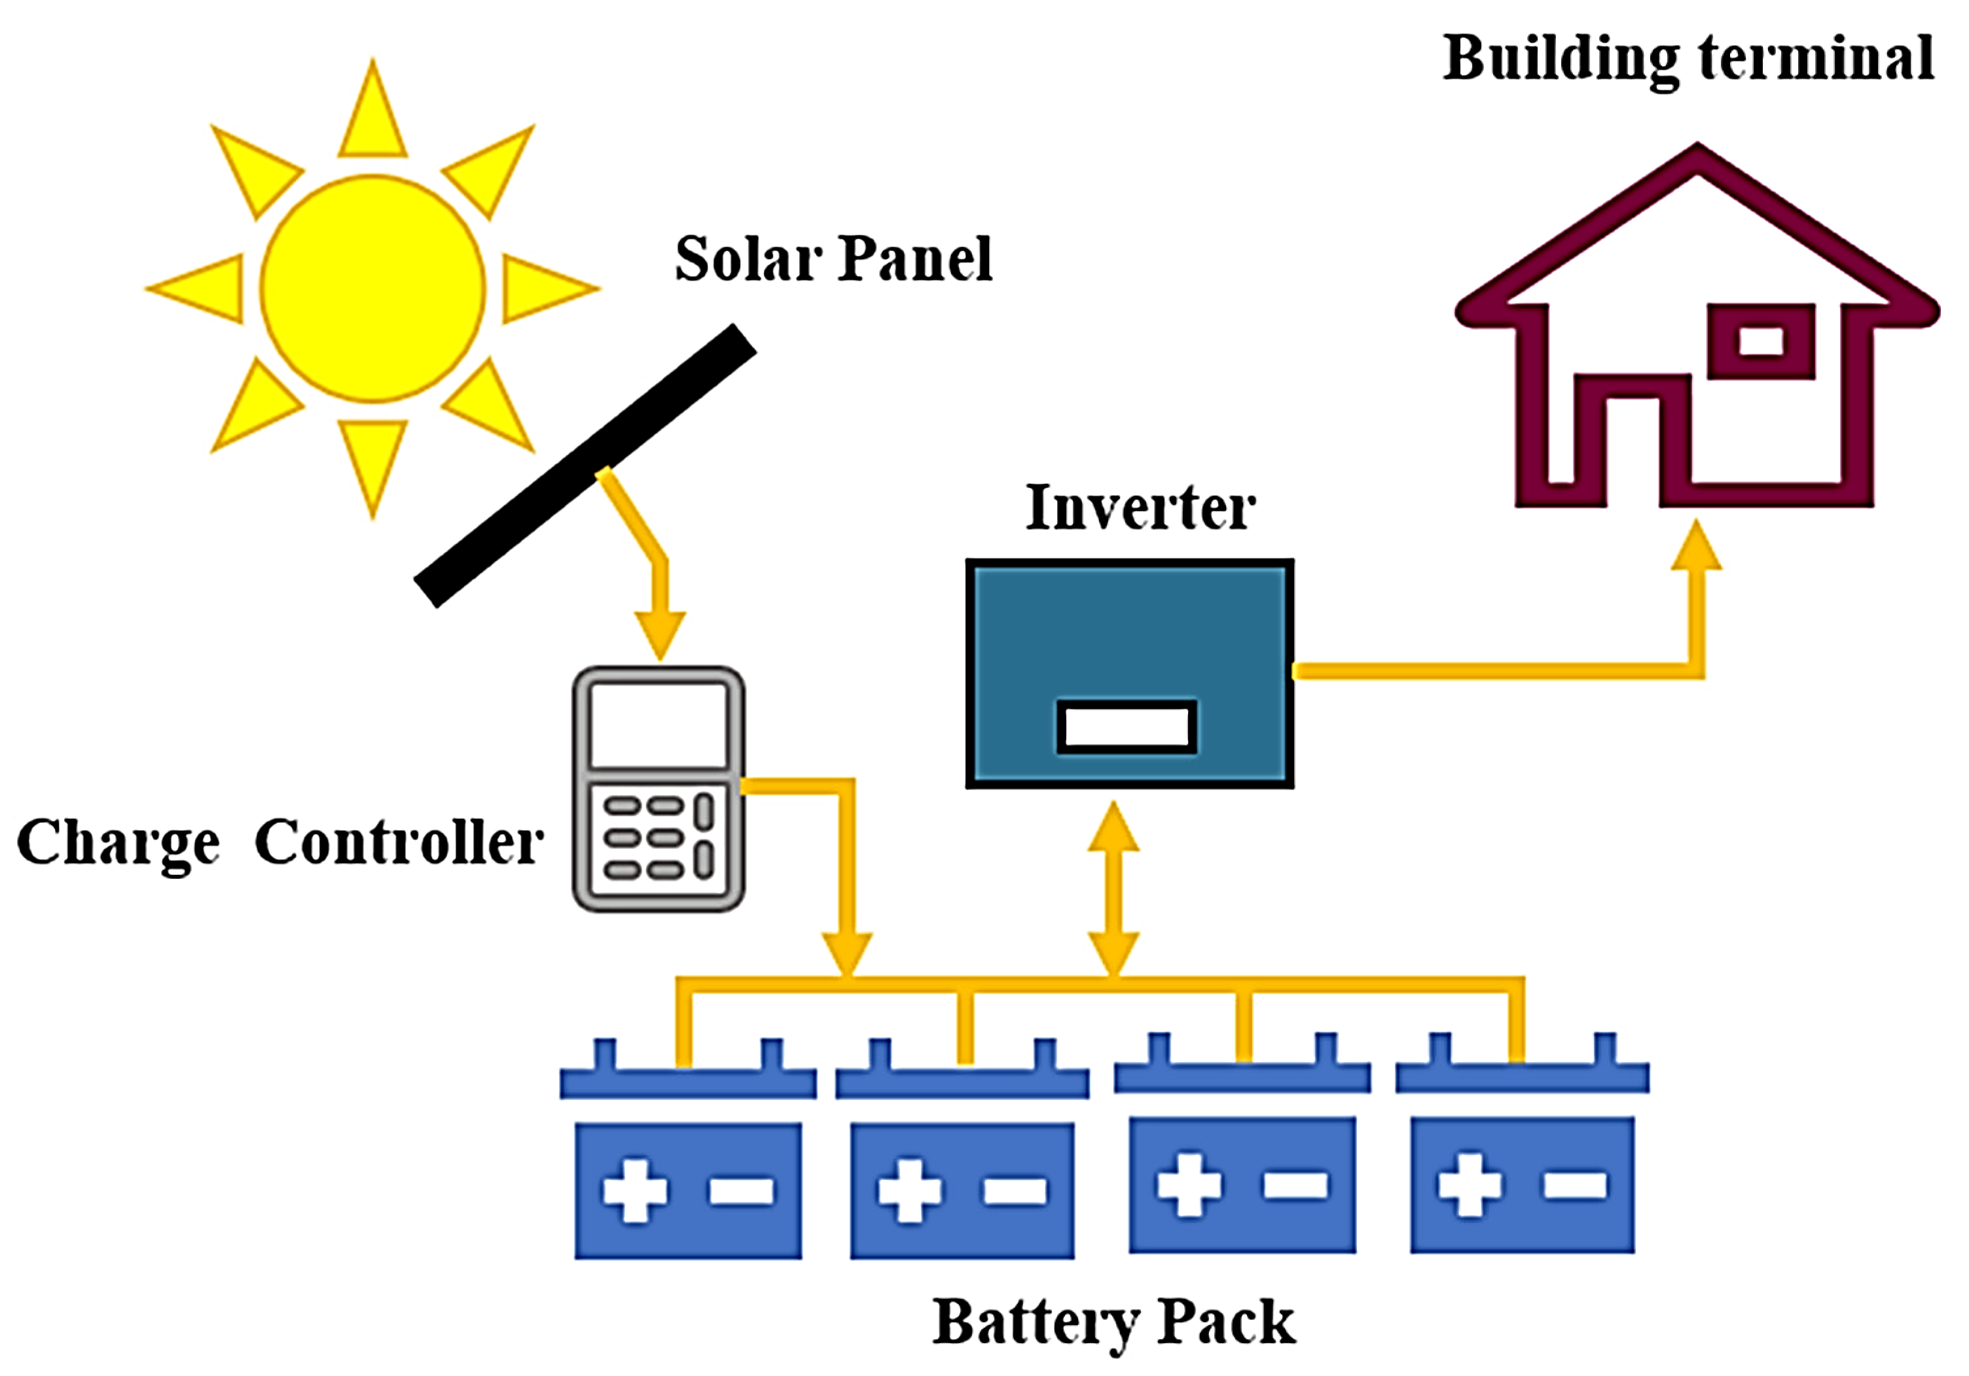
Fig: Battery operation
Parameters affecting on battery:
Voltage (V) : Battery's electrical potential.
Capacity (Ah) : How much energy it can store (e.g., 100 Ah).
Depth of discharge (DoD) : How much of the battery is used.
State of charge (SoC) : Current battery level (like fuel gauge).
Cycle life : Number of charge/discharge cycles battery can perform.

Slide 30
Types of batteries:
Different types of batteries are applicable for PV system. The most important are mentioned below:
Lead-acid
Lithium-ion
Nickel-based
Lead-acid batteries:
Most commonly used in solar systems.
Low cost and easy to maintain.
Available in:
Flooded Lead-Acid (FLA) : Needs regular water refilling.
Sealed Lead-Acid (SLA) : Maintenance-free.
Disadvantages: Heavy, shorter life, emits gas (needs ventilation).
Lithium-ion batteries
Modern and high-performance batteries.
Longer life, lightweight, and faster charging.
Takes less space and works efficiently.
Disadvantages: High cost.

Slide 31
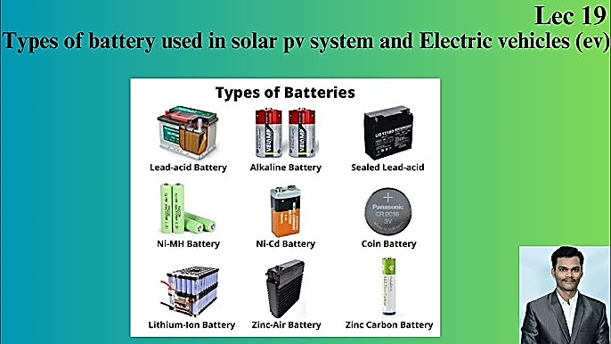
Nickel-Based Batteries (e.g., Ni-Cd):
Used in special applications.
Long life and works well in extreme temperatures.
Disadvantages: Costly and not commonly used in home PV systems.
Comparison among batteries:
Type | Cost | Life | Maintenance | Common Use
Lead-Acid | Low | Medium | Medium | Widely used
Lithium-Ion | High | Long | Low | Modern PV
Nickel-Based | High | Long | Low | Rare/Special
Fig: Different types of batteries used in PV systems

Slide 32
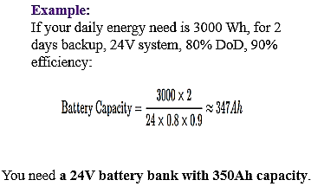
Selection of batteries for solar PV system:
To select the right battery for a solar PV system, consider the following key factors:
Battery Type:
Choose the battery based on system needs:
Type of Battery | Features | Suitability
Lead-Acid | Low cost, proven tech | Small to medium systems
Lithium-Ion | High efficiency, long life | Smart homes, high-end systems
Nickel-based (NiCd) | High temperature tolerance | Industrial or backup use
System Voltage Compatibility:
Match battery voltage with PV system (e.g., 12V, 24V, 48V).
Avoid mismatched voltages which may damage components.
Required Storage Capacity:
Use the formula:
Consider:
Daily Load (energy usage)
Autonomy Days (days of backup required)
Depth of Discharge (DoD) (how much of the battery can be used)
Efficiency (usually 85–95%)

Slide 33
Depth of discharge (DoD):
Higher DoD means more usable capacity.
Choose batteries with at least 50% DoD for deep cycling.
Cycle life:
Longer cycle life = longer battery life.
Lithium-ion typically lasts longer than lead-acid.
Temperature and environment:
Select batteries that can work in local climate.
Use ventilated enclosures for high-temperature areas.
Maintenance requirements:
Flooded Lead-Acid: Needs water topping & maintenance.
Lithium: Maintenance-free.
Cost vs performance:
Balance initial cost with long-term performance.
Lithium has higher cost but longer lifespan and efficiency.

Slide 34
Advantages of batteries in PV systems:
Energy Storage: Store excess solar energy for use at night or cloudy days.
Uninterrupted Power Supply: Provide backup power during grid outages.
Grid Independence: Enable off-grid solar systems in remote areas.
Load Shifting: Use stored energy during peak electricity rates.
System Stability: Help maintain voltage and frequency stability in hybrid or grid-connected systems.
Disadvantages of batteries in PV systems:
High Cost: Batteries add significant cost to the system.
Limited Lifespan: Batteries degrade over time and need replacement.
Maintenance Needs: Some battery types (like lead-acid) require regular maintenance.
Space Requirement: Batteries take up space and need proper installation.
Environmental Issues: Disposal of batteries can cause pollution if not handled properly.
Applications of batteries in PV systems:
Off-grid Solar Systems: In rural or remote areas without grid access.
Hybrid Solar Systems: Combine solar, battery, and grid power for flexibility.
Solar Street Lighting: Store energy during the day to power lights at night.
Telecommunication Towers: For backup power in off-grid or unreliable grid areas.
Residential Backup: To power homes during load shedding or blackouts.

Slide 35
Descriptive questions
Illustrate the PV Module circuit design with module structure.
Discuss the interconnections in solar panel.
Explain the importance of electrical and mechanical insulations in PV panel.
Calculate the life time of PV module by using degradation rate.
Elaborate the paraments affect on PV module.
Derive the equation for efficiency of PV module.
Design the off grid solar power plant with the help of circuit diagram.
Describe basic working principle of battery operation in PV system with a neat sketch.
Listout the different kinds of batteries for PV system and illustrate the any one with neat sketch.
What are the factors considered for selection of batteries for PV systems.
Short answer questions
Mention the applications of PV cell systems.
Define package density.
What are the consequences of mismatching and temperature effects on PV module.
Define battery and list the battery parameters for PV systems.
List the merits and demerits of batteries.
Assignment questions
Analyze the I-V characteristics of PV module.
Illustrate the working of on grid solar power plant with the help of circuit diagram.
Differentiate off grid solar power plant and on grid solar power plants.
Elaborate the various applications of batteries.

